Slide 1
Basic Market Stock System in Java
made by
Dirsehan Başaran İzzet Can Korkmaz
Yusuf Ziya Kural Gökmen Veyisoğlu

Slide 2

Components Of The System
It’s Goal Take The List of Entered Products to The Market’s Stock
Total Product Number of the Chosen Category
(Product Type)
The System
The Table
The Products Type
(Meat,Fruit,Vegetable)
The Products Given Unit Price
Given Product Name
The Products Given Amount
The Products Real Time Enterence Date

Slide 3
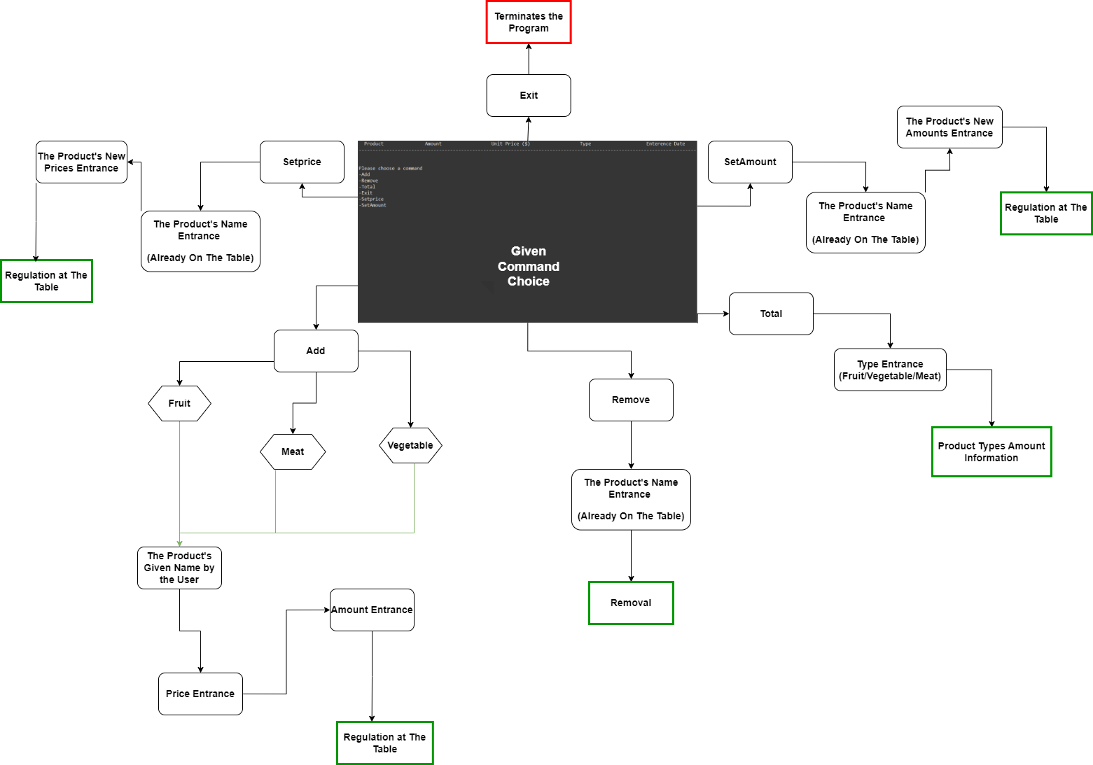
The System’s Working Procedure

Slide 4
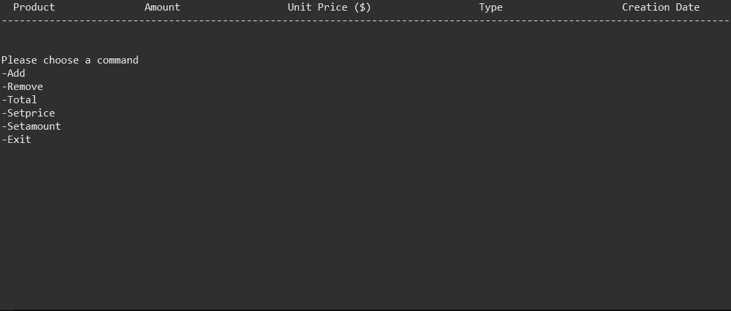

Slide 5
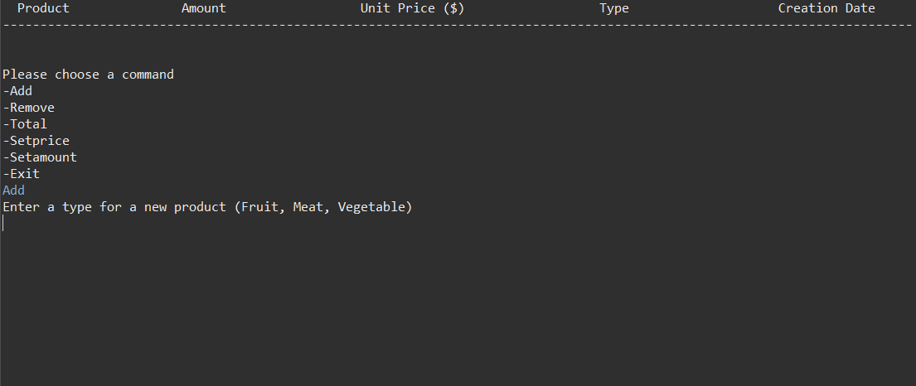

Slide 6
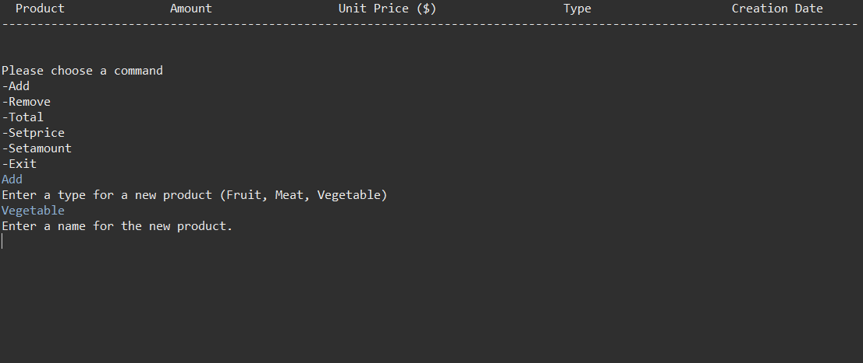

Slide 7
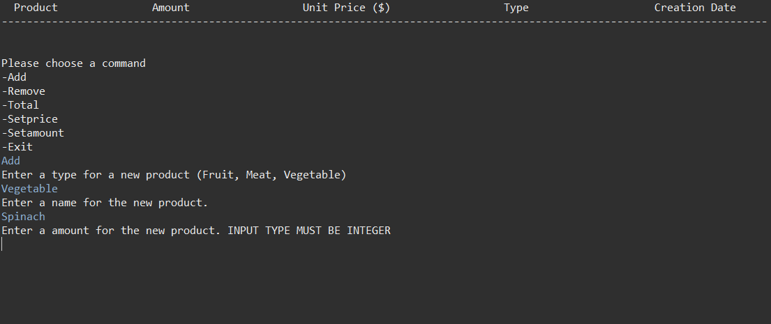

Slide 8
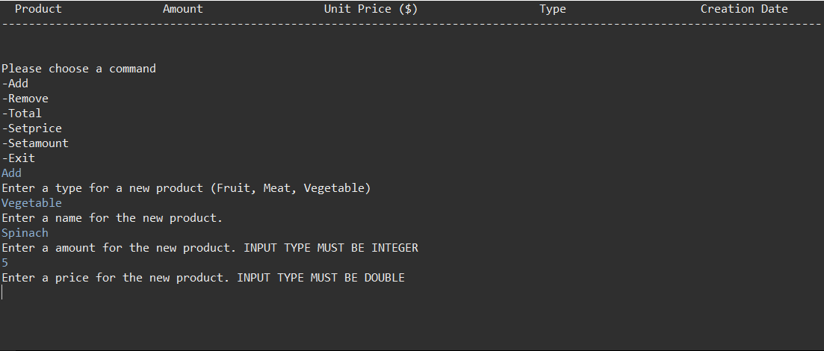

Slide 9
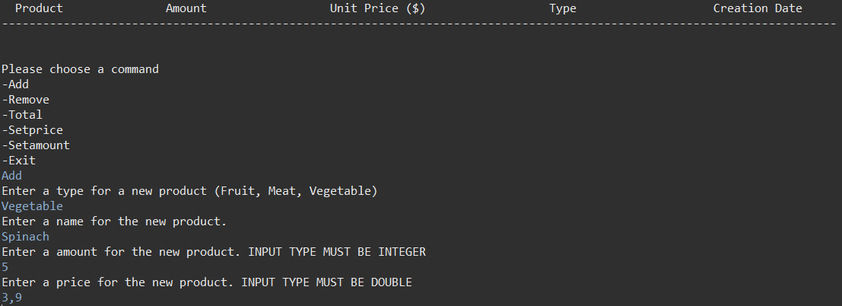

Slide 10
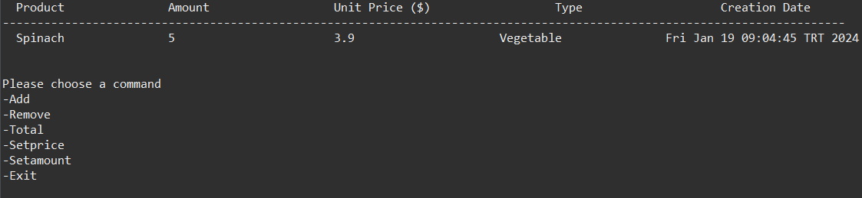

Slide 11
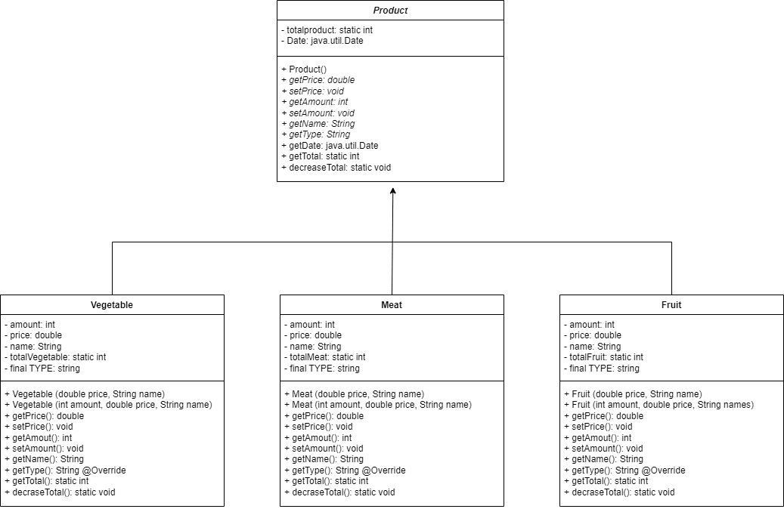
UML Diagram

Slide 12
Testing And Showing The Features
of
The Program

